Slide 1
Python - Installation

Slide 2

Table of contents
01
03
04
Python Installation
02
Comments
Variables
Datatypes

Slide 3


01
Python Installation

Slide 4

What is Python ?
Open your browser and go to site : https://www.python.org/downloads/

Slide 5
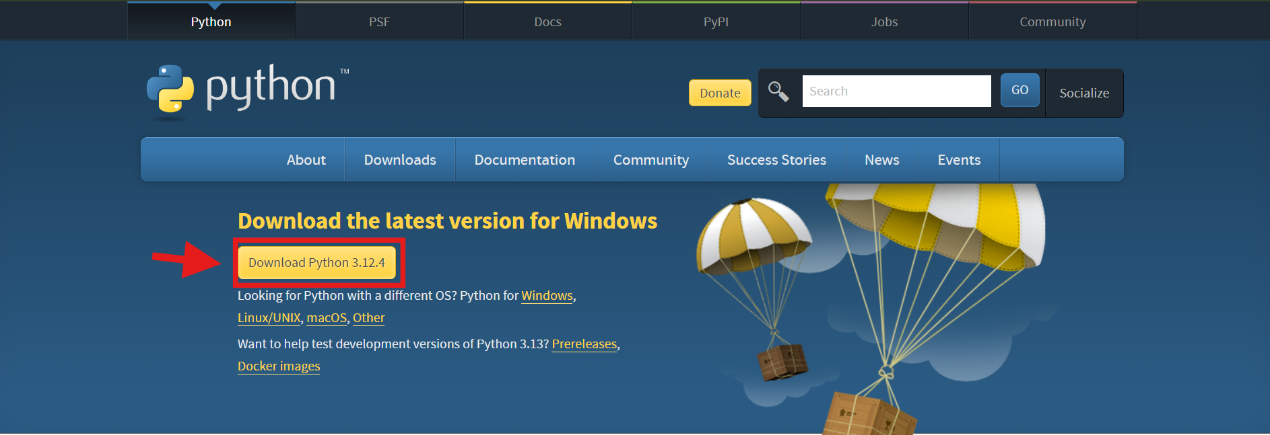
Python Installation
Click the download button to install the latest python version in your system.

Slide 6
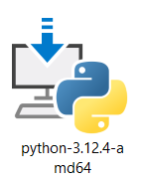
Python Installation
In your system go to downloads folder and then open the python file which is downloaded now and then click install.

Slide 7
02
Comments

Slide 8
Comments
Comments can be used to make the code more readable.
Comments can be used to prevent execution while testing code.
Single Line Comment:
# This is a comment
Multi Line Comments
“ ” ”This is a multi-line
comment “ “ “

Slide 9
03
Variables

Slide 10
Variables
Variables are used to store data values like numbers, strings or lists.
Variables are dynamically typed, meaning you don’t need to declare their type and they can change type as needed. X = ‘hello’

Slide 11
Rules to create Variables
A variable name must start with a letter or the underscore character.
A variable name can only contain alpha-numeric characters and underscores (A-Z, 0-9 and _ ).
A variable name cannot start with a number.
Variable names are case-sensitive(myvar, Myvar, MYVAR are three different variables).
A variable nme cannot be any of the Python keywords(break, continue,while etc…).

Slide 12
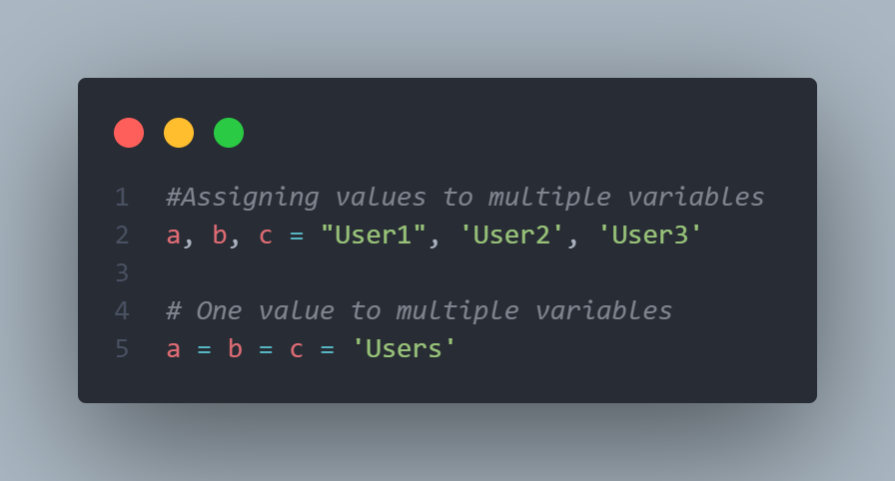
Assigning Multiple Values

Slide 13
04
Datatypes

Slide 14
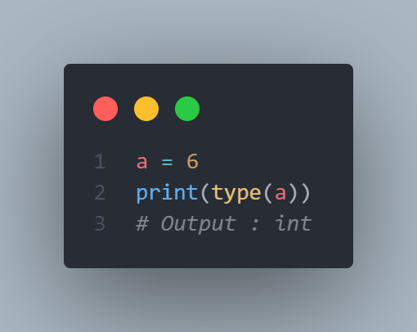
Datatypes
Datatypes is used to mention the type of data stored in a variable.
The different Datatypes are
Int
Str
Float
Bool
range
List
Tuple
Set
Dict

